Slide 1
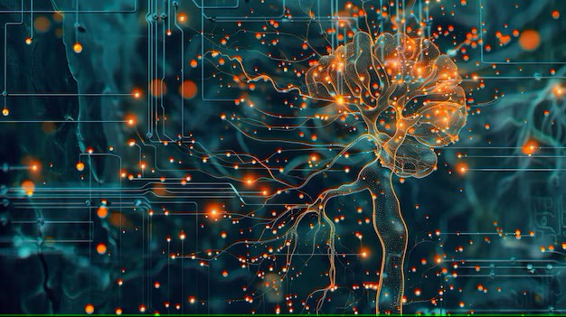



Week-12 (Discussion)
8th Apr, 2025
Deep Learning
Prof. Sudarshan Iyenger
Professor and Head of the Department
Department of Computer Science and Engineering
IIT Ropar
Ayan Paul
PMRF Research Scholar
IIT Kharagpur

Slide 2
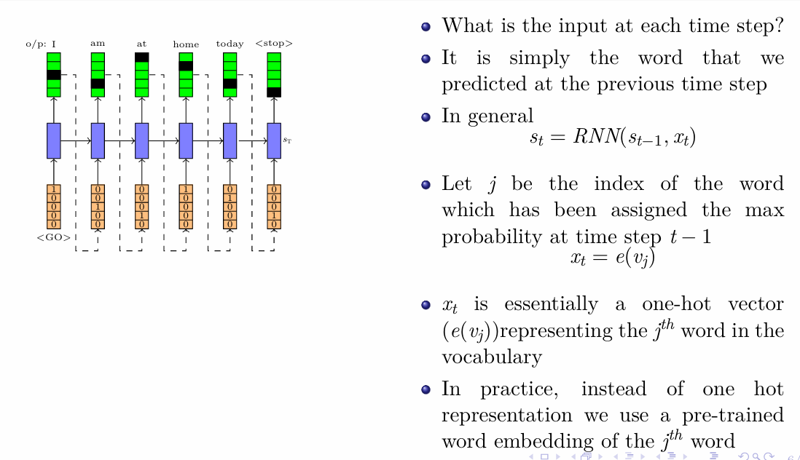
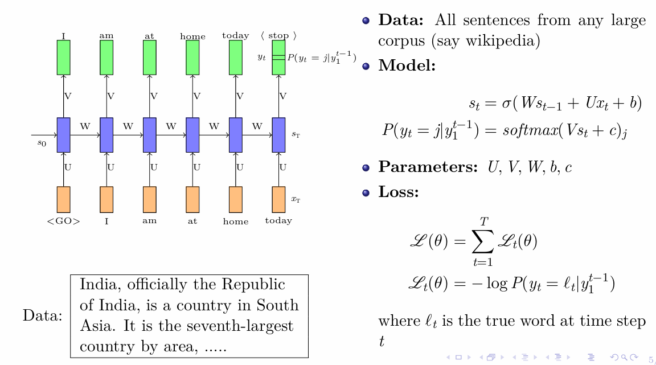
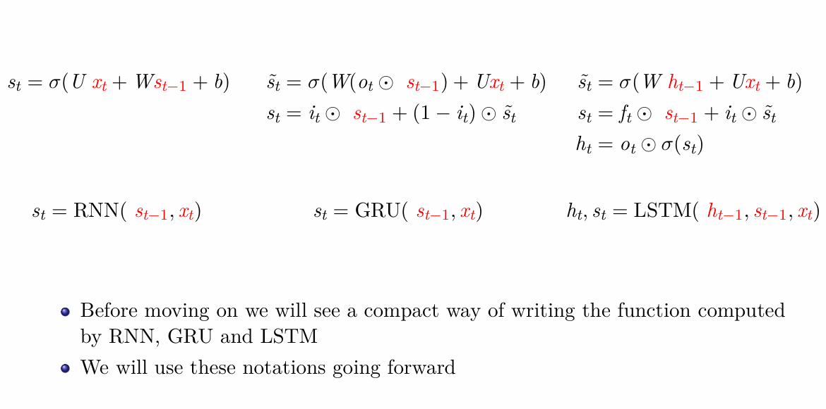
Revisiting RNNs

Slide 3
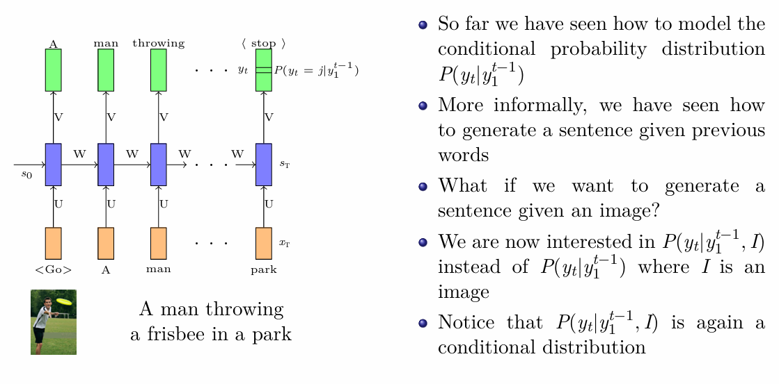
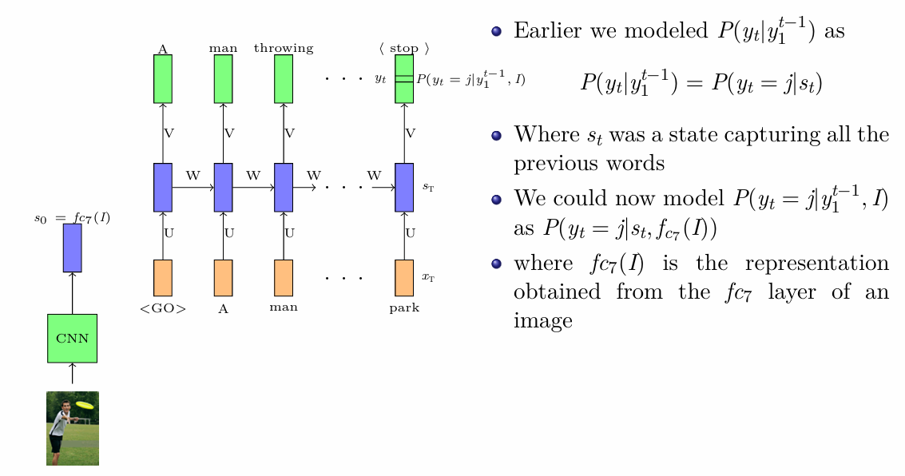
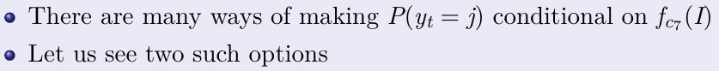
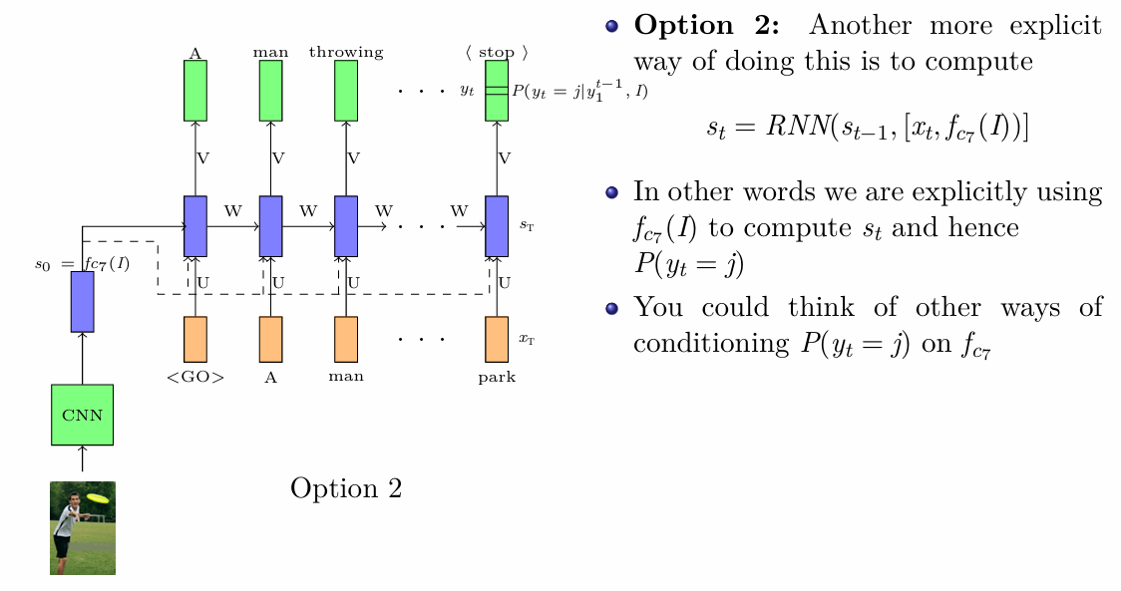
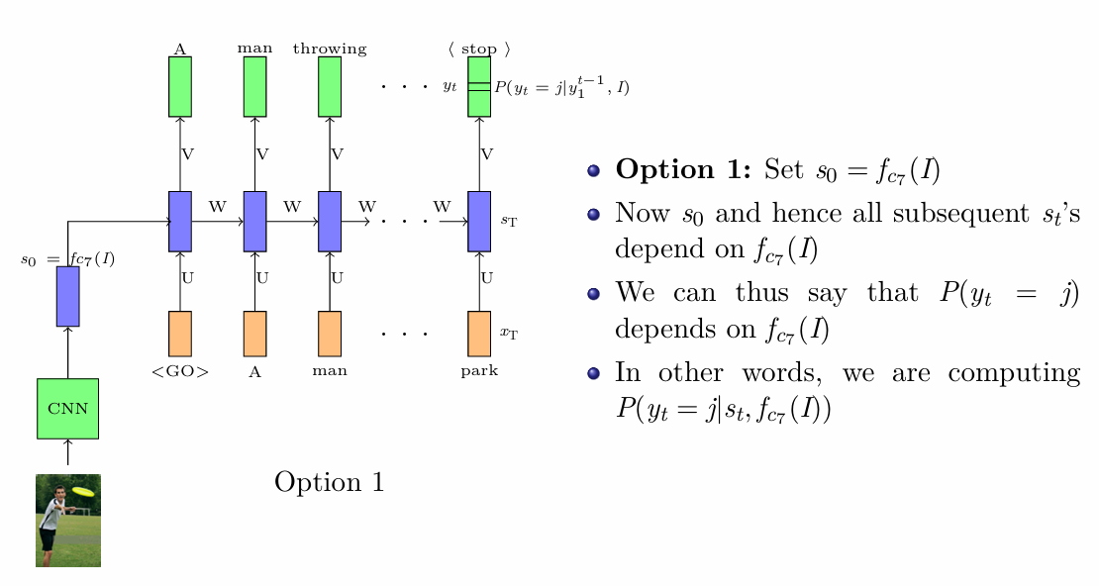
Introduction to Encoder Decoder Models

Slide 4
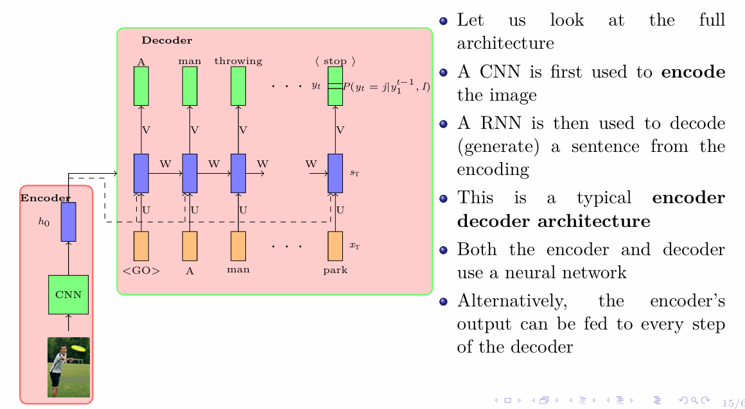
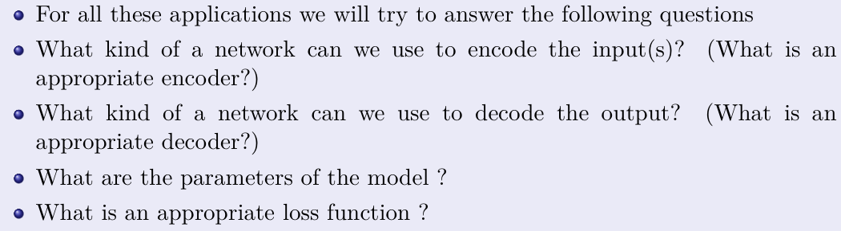
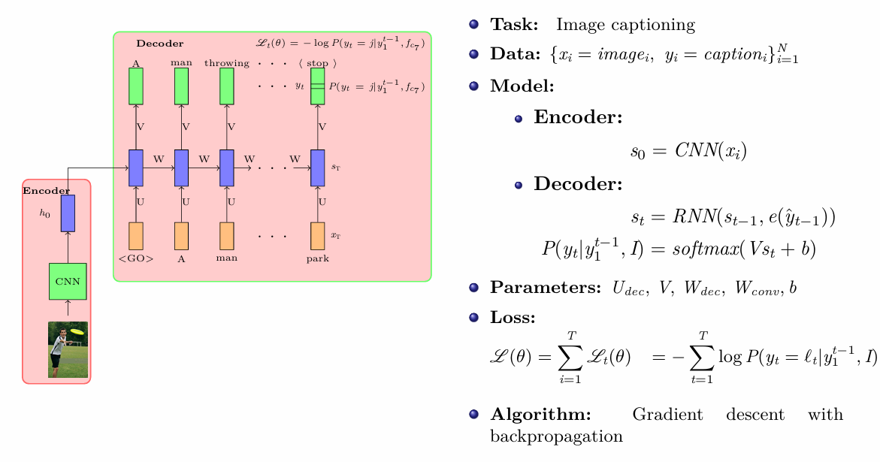
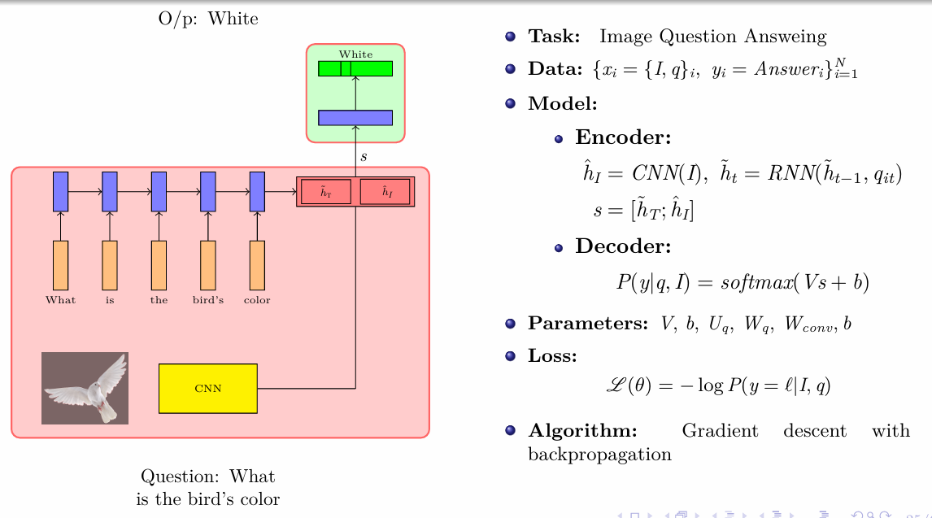
Applications of Encoder Decoder Models

Slide 5
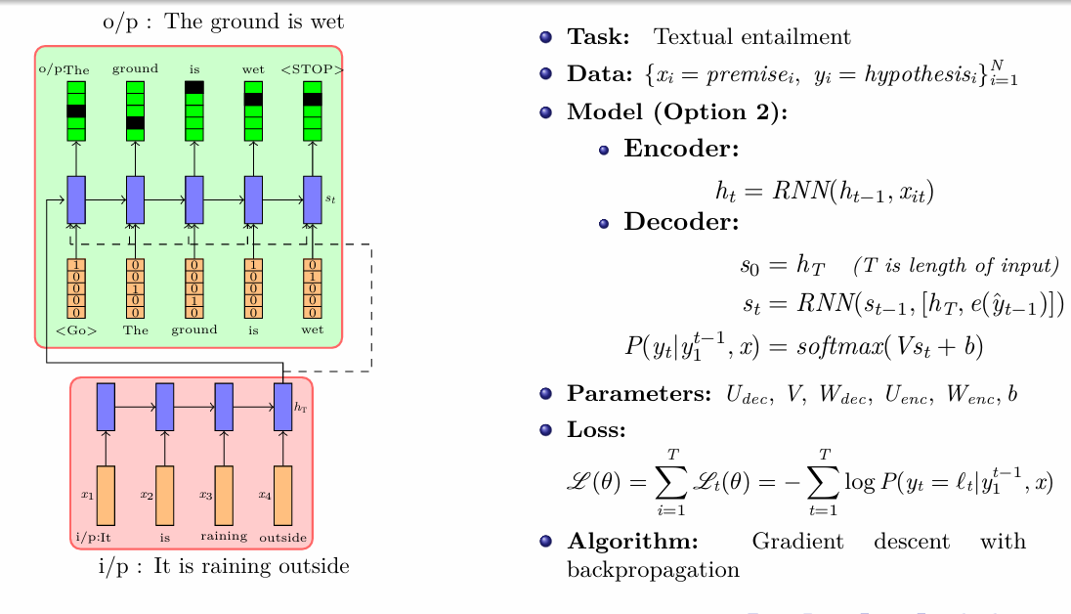
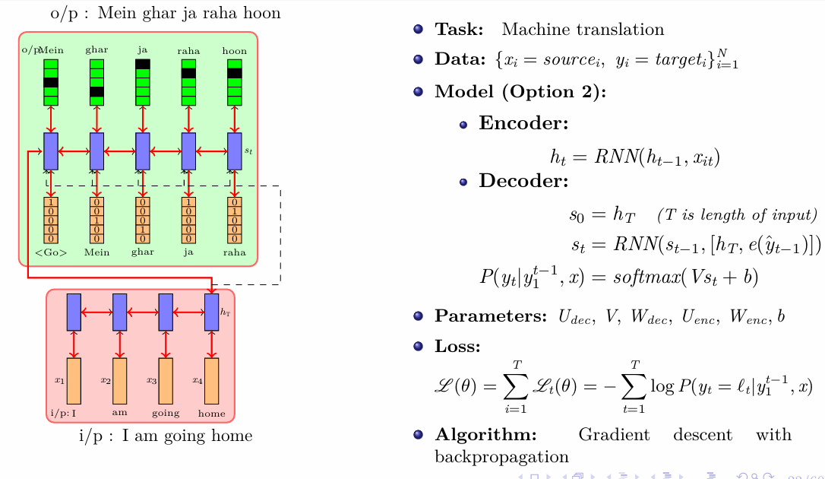
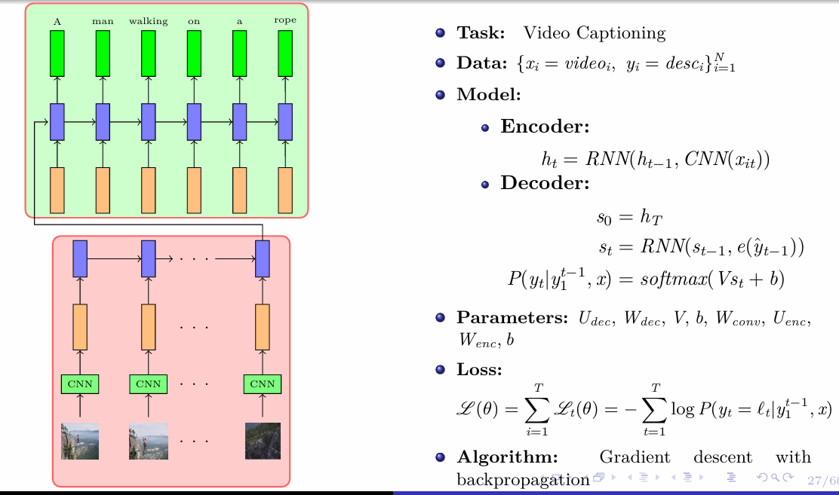
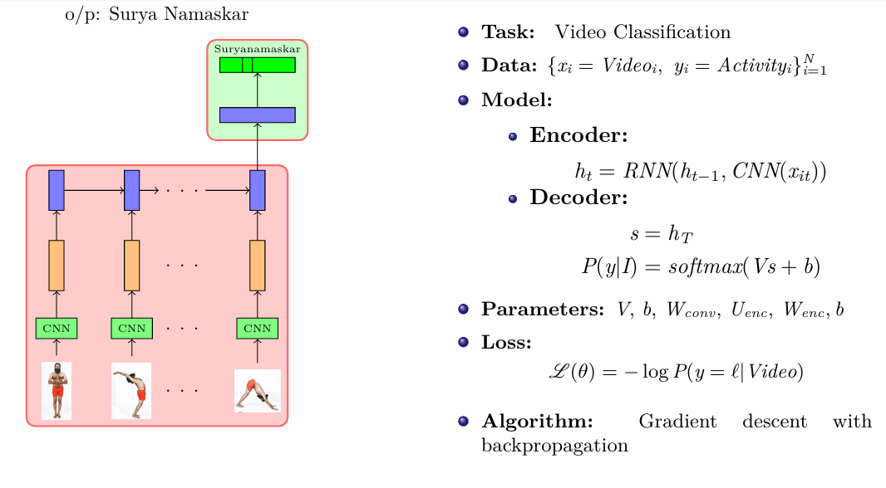

Slide 6
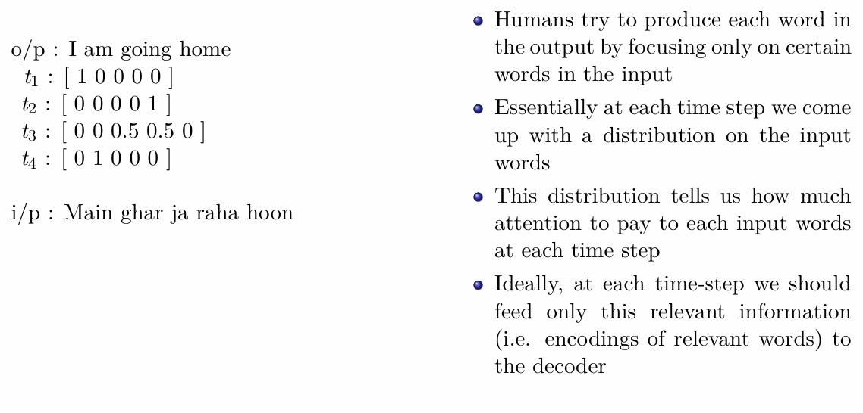
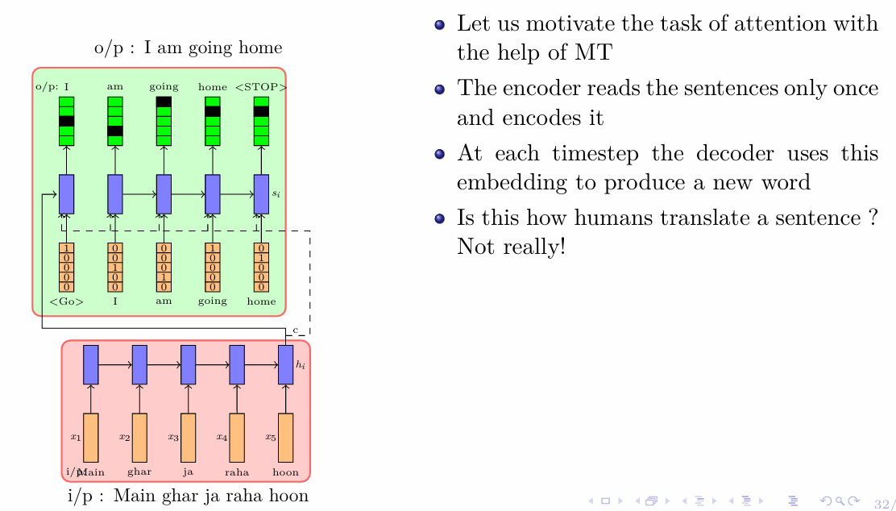
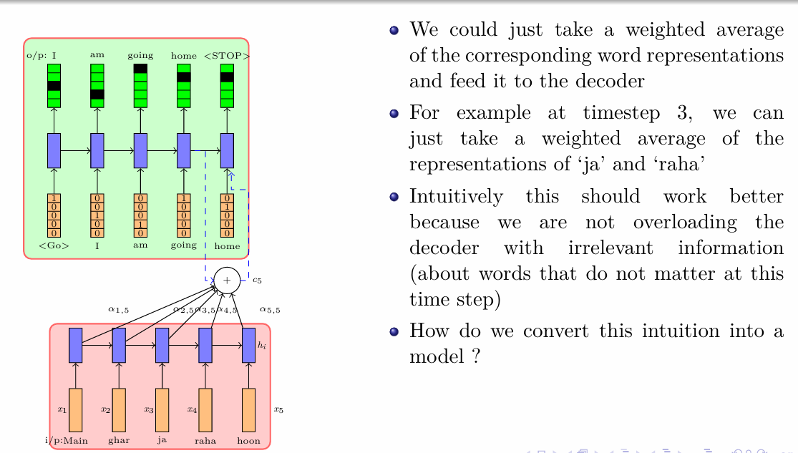
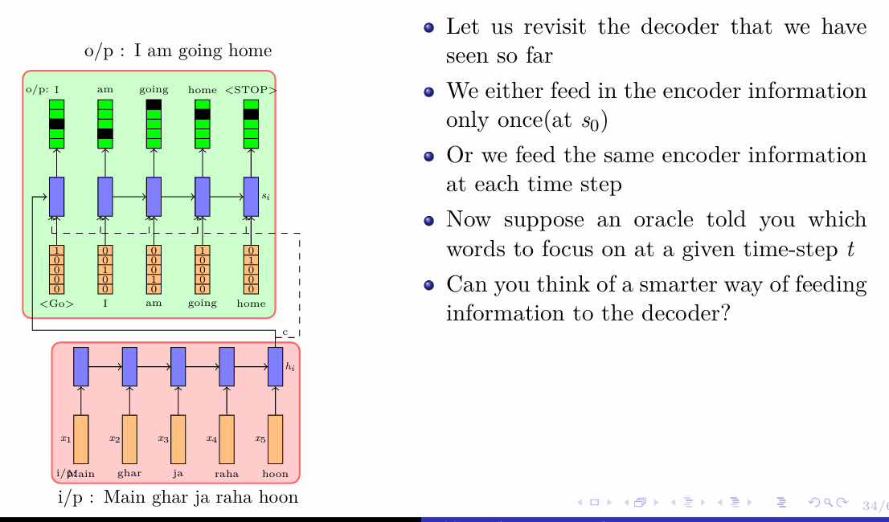
Attention Mechanism

Slide 7
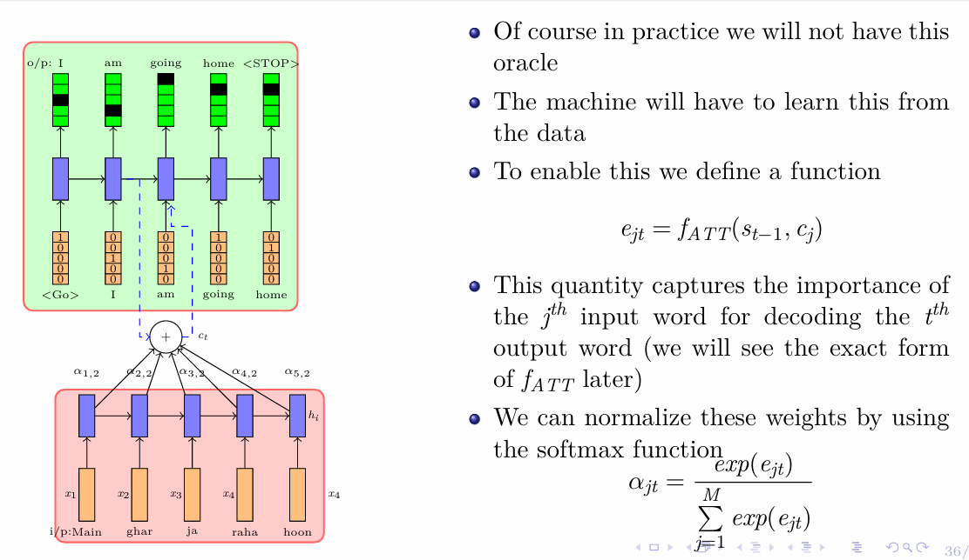
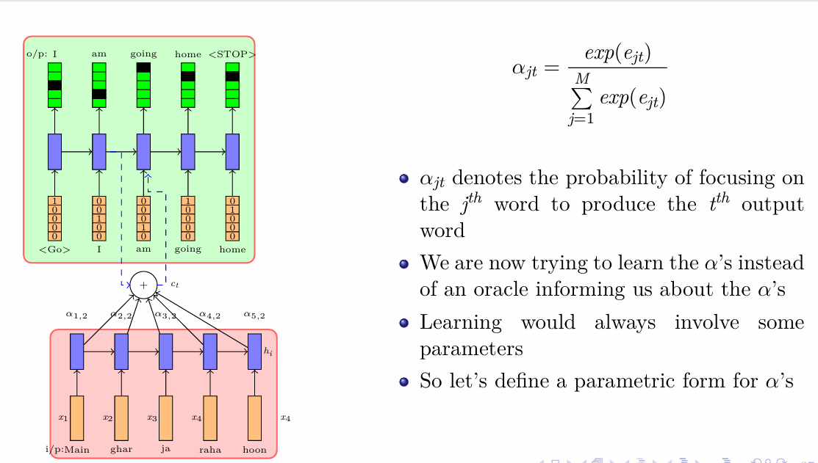
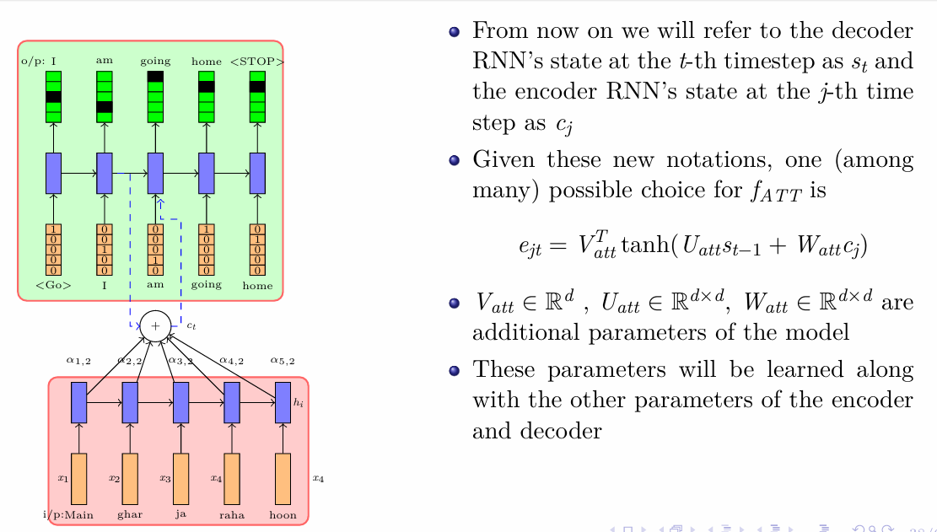
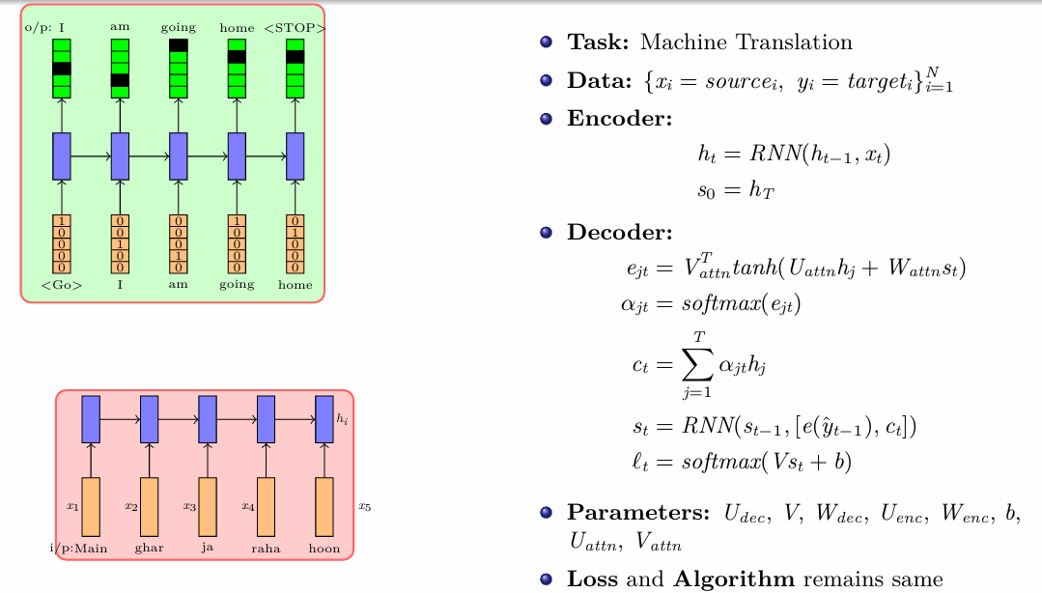

Slide 8
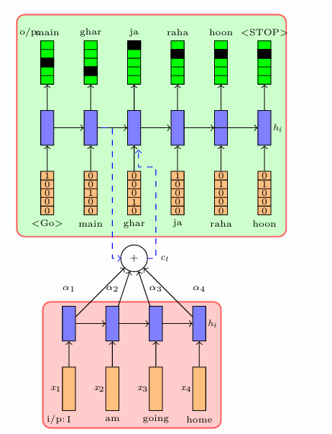
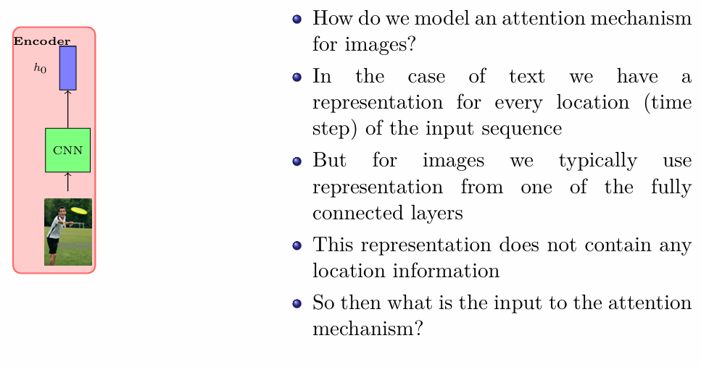
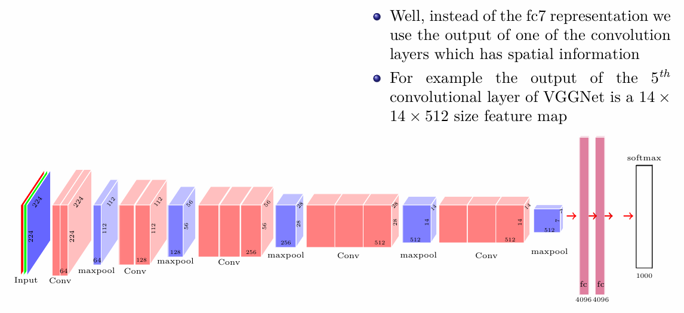
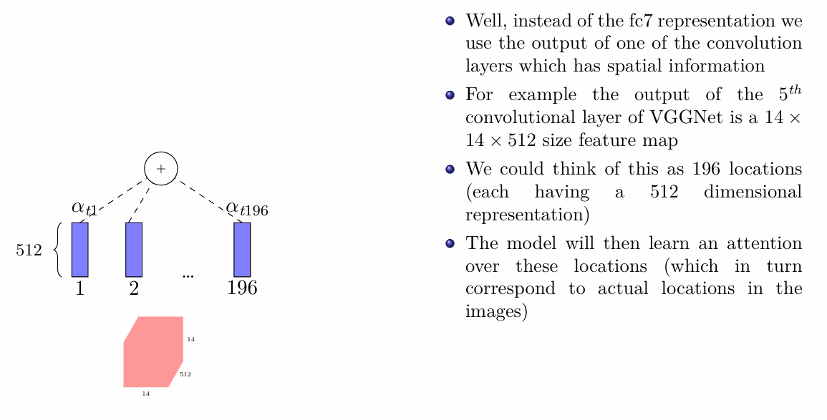
Attention over images

Slide 9
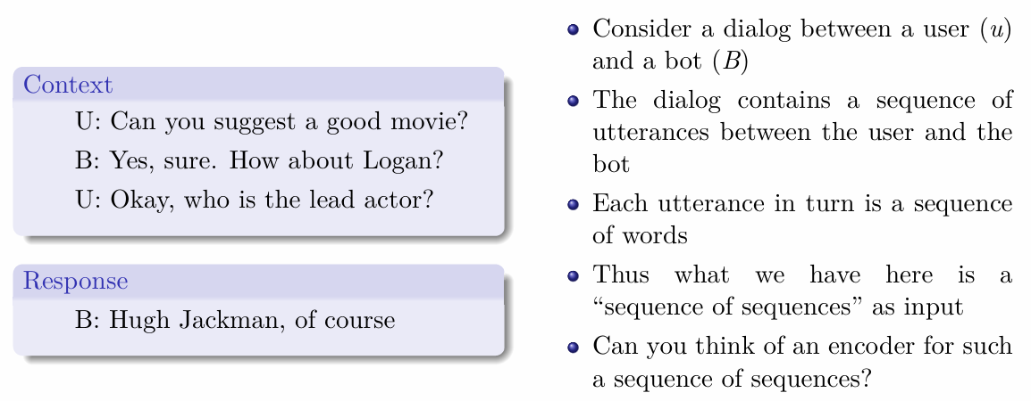
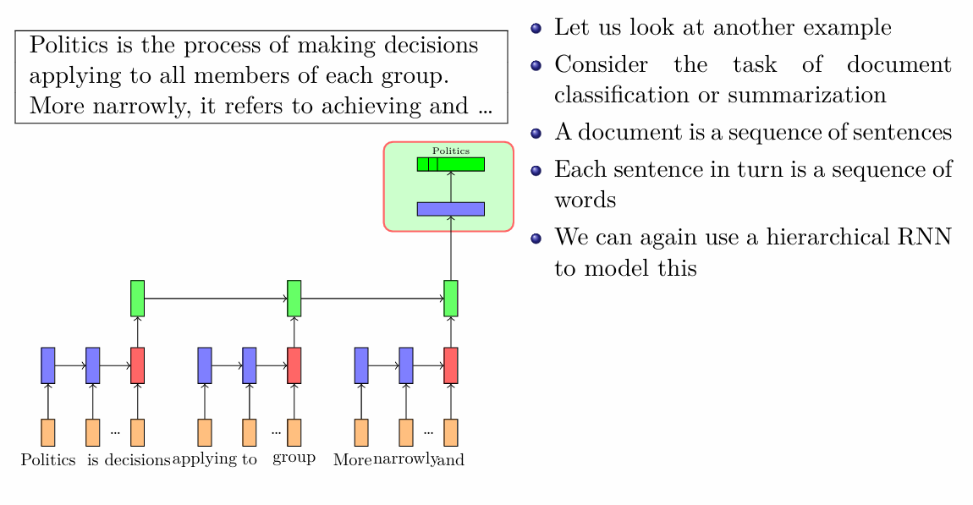
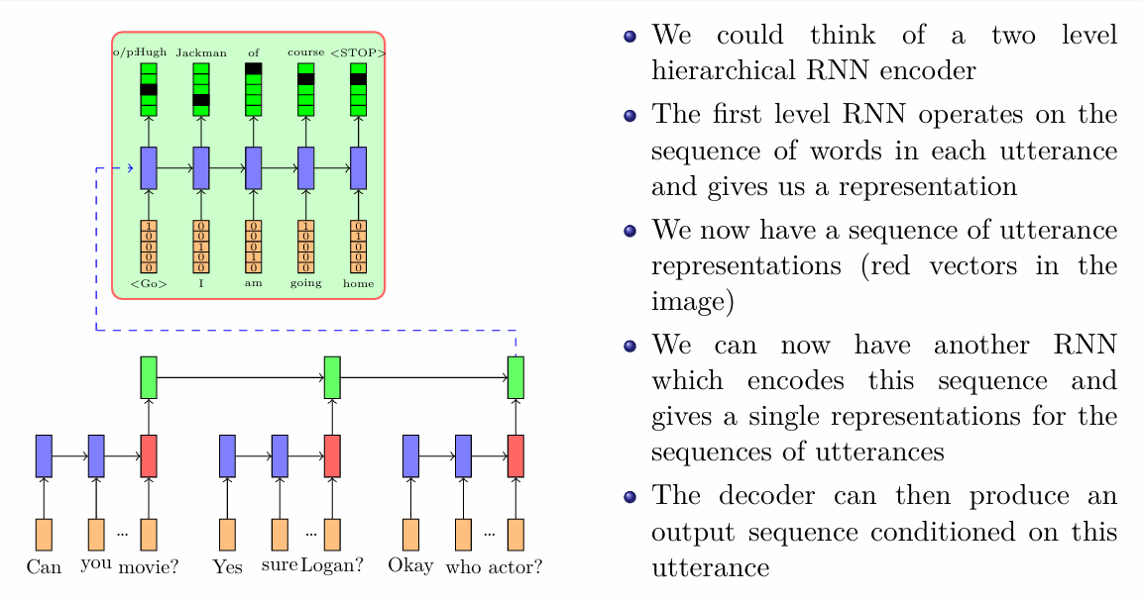
Hierarchical RNN

Slide 10
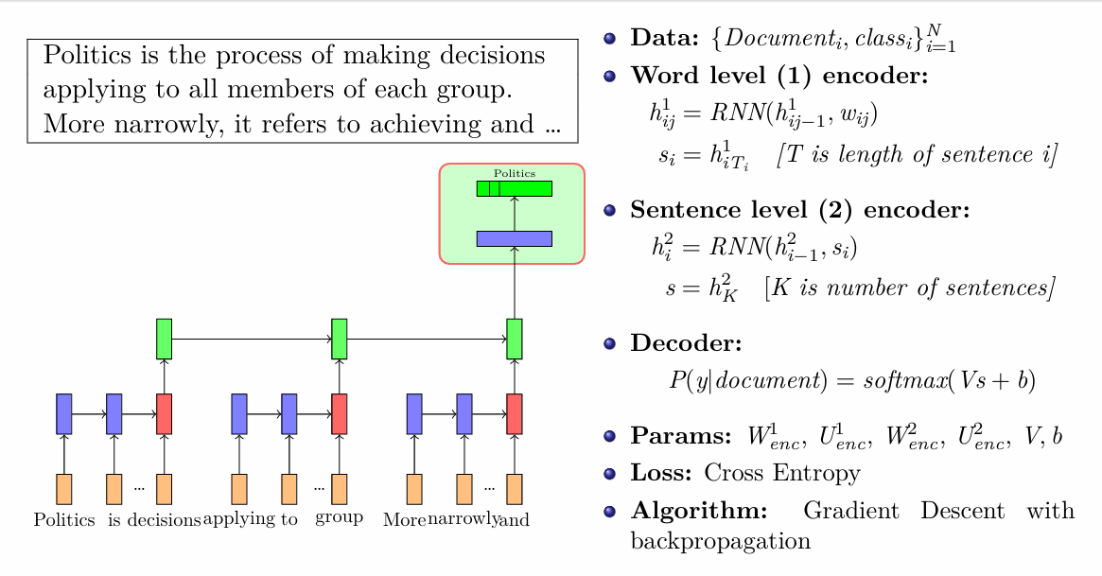
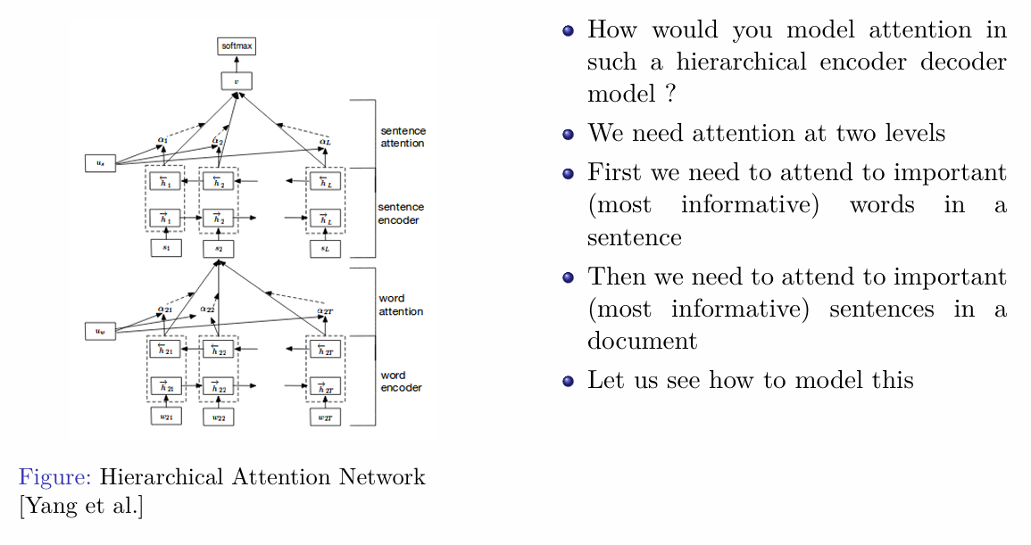
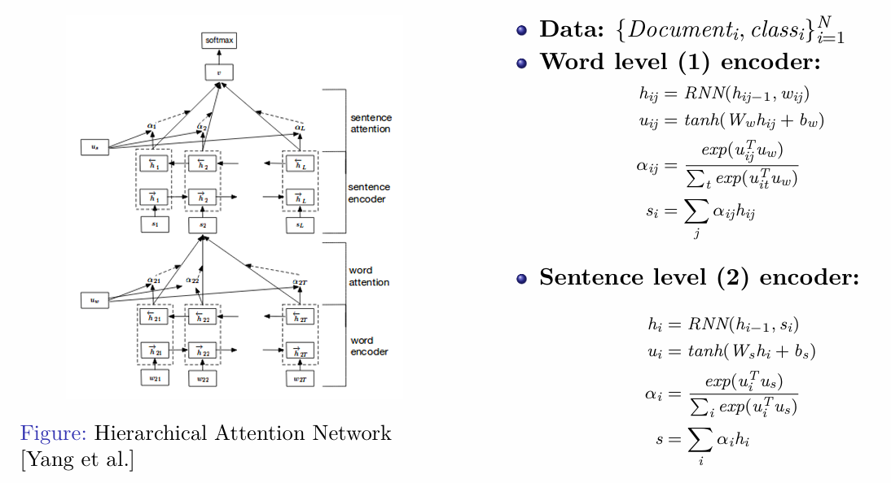
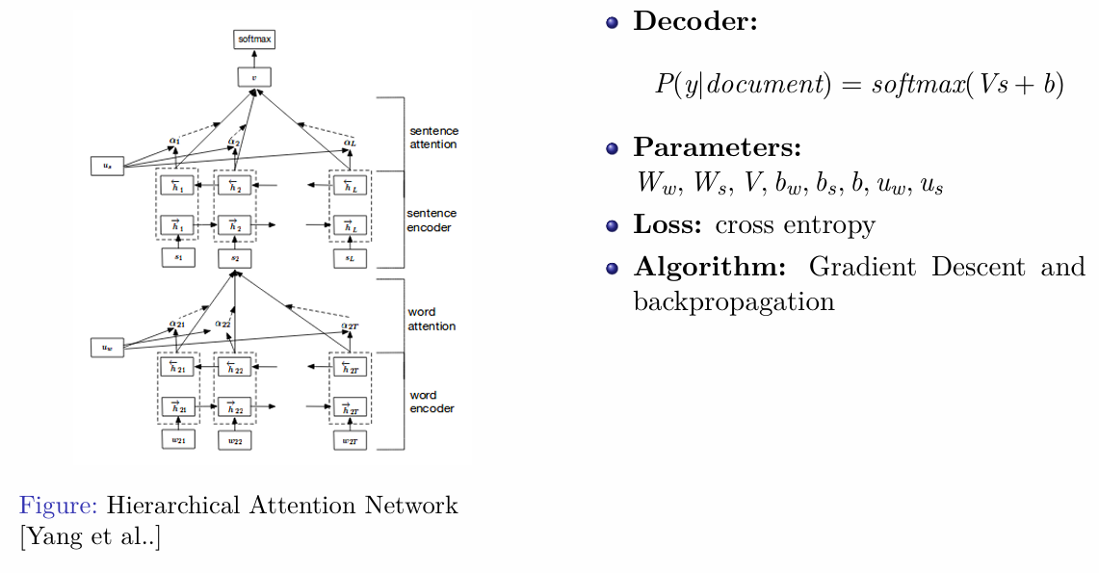
Attention in Hierarchical RNNs

Slide 11
Topics on which Week 12 Assignment Questions are based
Introduction to Encoder Decoder Models
Applications of Encoder Decoder Models
Attention Mechanism
Attention over images
Hierarchical RNN
Attention in Hierarchical RNNs

Slide 12
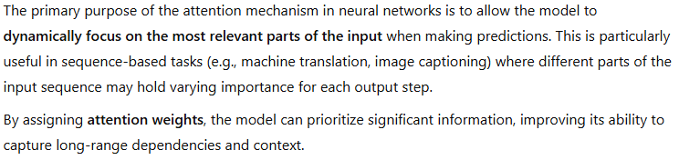
QUESTION 1
What is the primary purpose of the attention mechanism in neural networks?
To reduce the size of the input data
To focus on specific parts of the input sequence
To increase the complexity of the model
To eliminate the need for recurrent connections
SOLUTION 1
CORRECT ANSWER 1
b)

Slide 13
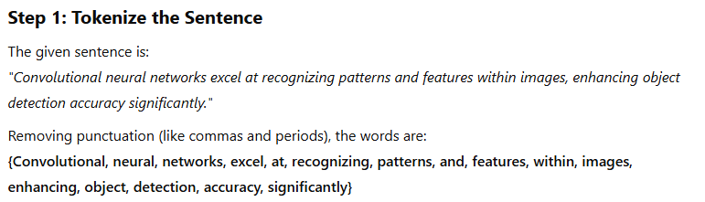
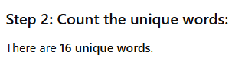
QUESTION 2
If we make the vocabulary for an encoder-decoder model using the given sentence. What will be the size of our vocabulary?
Sentence: Convolutional neural networks excel at recognizing patterns and features within images, enhancing object detection accuracy significantly.
13
18
14
16
SOLUTION 2
CORRECT ANSWER 2
d)

Slide 14
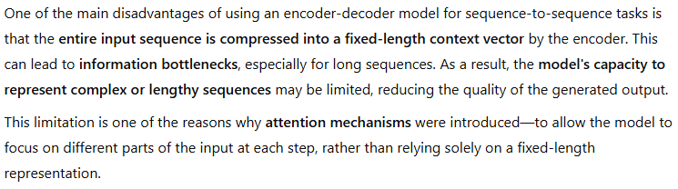
QUESTION 3
Which of the following is a disadvantage of using an encoder-decoder model for sequence-to-sequence tasks?
The model requires a large amount of training data
The model is slow to train and requires a lot of computational resources
The generated output sequences may be limited by the capacity of the model
The model is prone to overfitting on the training data
SOLUTION 3
CORRECT ANSWER 3
c)

Slide 15
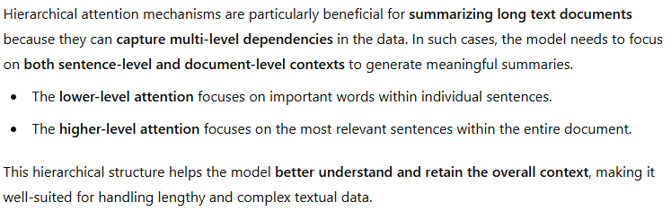
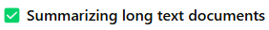
QUESTION 4
Which scenarios would most benefit from hierarchical attention mechanisms?
Summarizing long text documents
Classifying images in a dataset
Analyzing customer reviews or feedback data
Real-time processing of sensor data
SOLUTION 4
CORRECT ANSWER 4

Slide 16
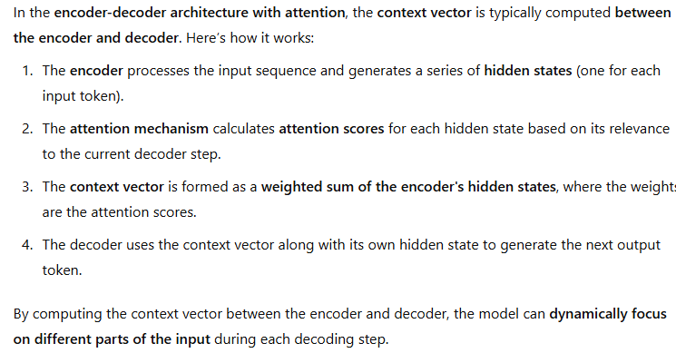

QUESTION 5
In the encoder-decoder architecture with attention, where is the context vector typically computed?
In the encoder
In the decoder
Between the encoder and decoder
After the decoder
SOLUTION 5
CORRECT ANSWER 5
c)

Slide 17
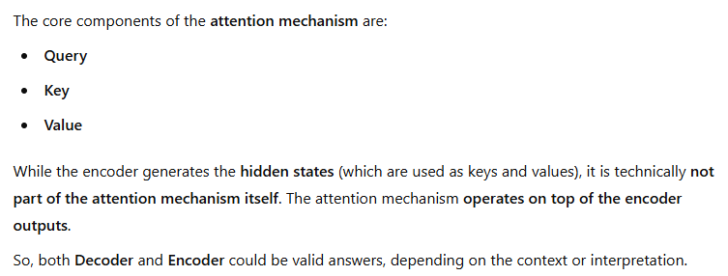
QUESTION 6
Which of the following is NOT a component of the attention mechanism?
Decoder
Key
Value
Encoder
SOLUTION 6
CORRECT ANSWER 6
a), d)

Slide 18
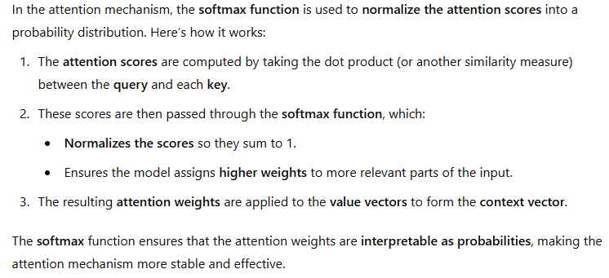
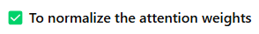
QUESTION 7
What is the purpose of the softmax function in the attention mechanism?
To normalize the attention weights
To compute the dot product between the query and key vectors
To compute the element-wise product between the query and key vectors
To apply a non-linear activation function to the attention weights
SOLUTION 7
CORRECT ANSWER 7
a)

Slide 19
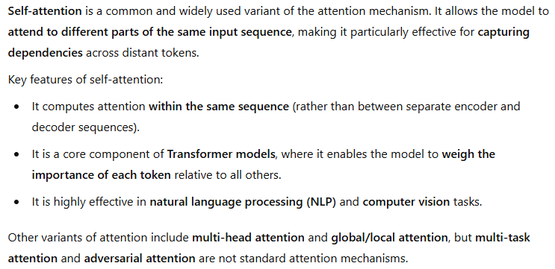
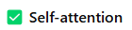
QUESTION 8
Which of the following is a common variant of the attention mechanism?
Self-attention
Multi-task attention
Adversarial attention
Transfer learning attention
SOLUTION 8
CORRECT ANSWER 8
a)

Slide 20
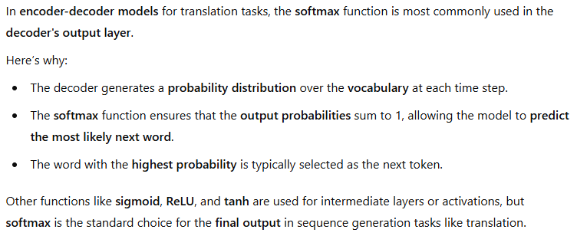
QUESTION 9
Which of the following output functions is most commonly used in the decoder of an encoder-decoder model for translation tasks?
Sigmoid
ReLU
Softmax
Tanh
SOLUTION 9
CORRECT ANSWER 9
c)

Slide 21
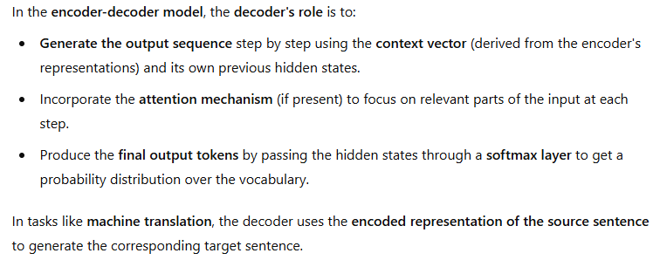
QUESTION 10
In the encoder-decoder model, what is the role of the decoder?
To generate output based on the input representations
To encode the input
To learn the attention mechanism
None of the above
SOLUTION 10
CORRECT ANSWER 10
a)

